Slide 1
https://www.youtube.com/watch?v=zzu2POfYv0Y

Slide 2
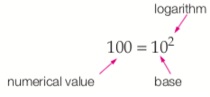
24
7
30
Date
Logarithms
EQ – What are Logarithms?
Logarithm is another word for power or index. We know that 10² = 100, so we say the logarithm of 100 to the base 10 is 2.
In this case, we used 10 as the base, but any number can be used. For example,
2³ = 8, so the logarithm of 8 to the base 2 is 3. We write this as $\log_{2}{8=3}$
Any number can be used as the base number, however the most frequently used values are 10 and 2. The log button on your calc will give you the base 10 logarithm for any number keyed in.
5
Notes:
Input

Slide 3

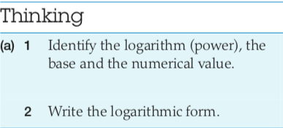
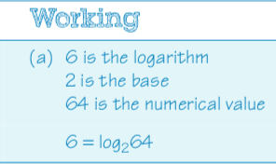
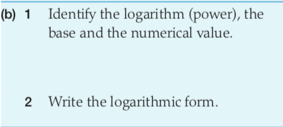
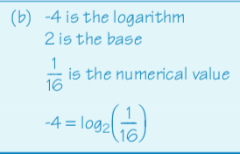
24
7
30
Date
Logarithms
EQ – What are Logarithms?
Ex:
Notes:
Input

Slide 4
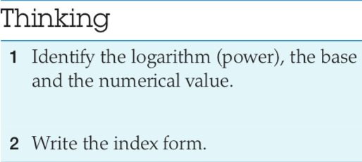
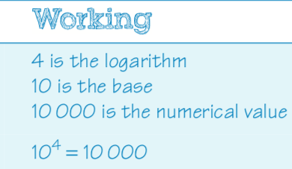
24
7
30
Date
Logarithms
EQ – What are Logarithms?
Ex:
Remember: Logarithm is just a different name for the familiar concepts of indices.
Break the question down into: 1) What is the logarithm 2) What is the base and 3) What is the numerical value to solve.
Notes:
Input

Slide 5
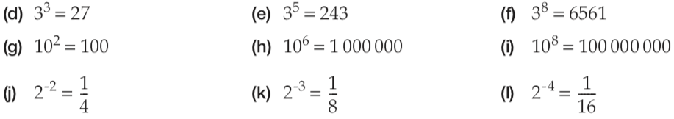
Your Turn
Now Finish These

Slide 6
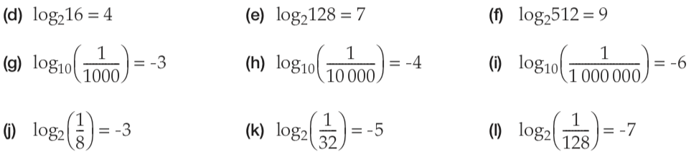
Your Turn
Now Finish These

Slide 7
Logarithms Worksheet

